Slide 1

Anatomy Team Tasks
Case 14
Back

Slide 2
Learning Outcomes
Identify the superficial and deep muscles of the back
Name the different part of the vertebrae and understand the clinical manifestations following fractures
Understand the anatomy of the spinal cord and the meninges and their applied anatomy
Describe the anatomy of the ligaments of the spine
Describe the anatomy of the intervertebral disc and their applied anatomy
Describe the anatomy of the spinal conditions

Slide 3
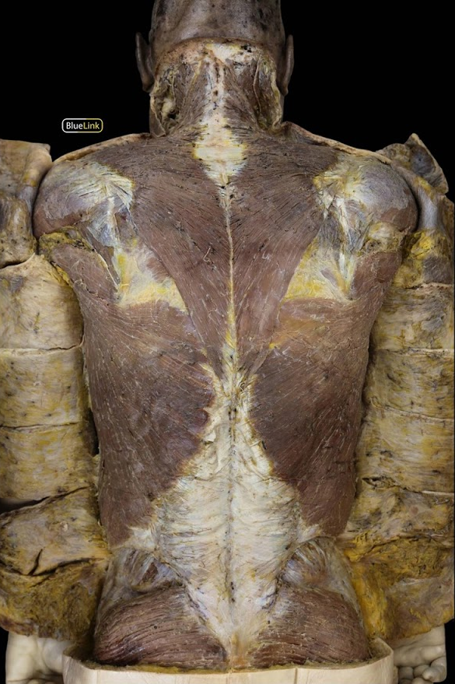
Task 1- Muscles of the back
a. Label the superficial muscles of the back ‘A’ and ‘B’.
Type your answer here:
Type your answer here:
A
b. Name the innervations for the muscles ‘A’ and ‘B’.
Type your answer here:
B
Type your answer here:
c. Under which class of nerves would you categorise the innervation of muscle ‘A’?
Type your answer here:

Slide 4
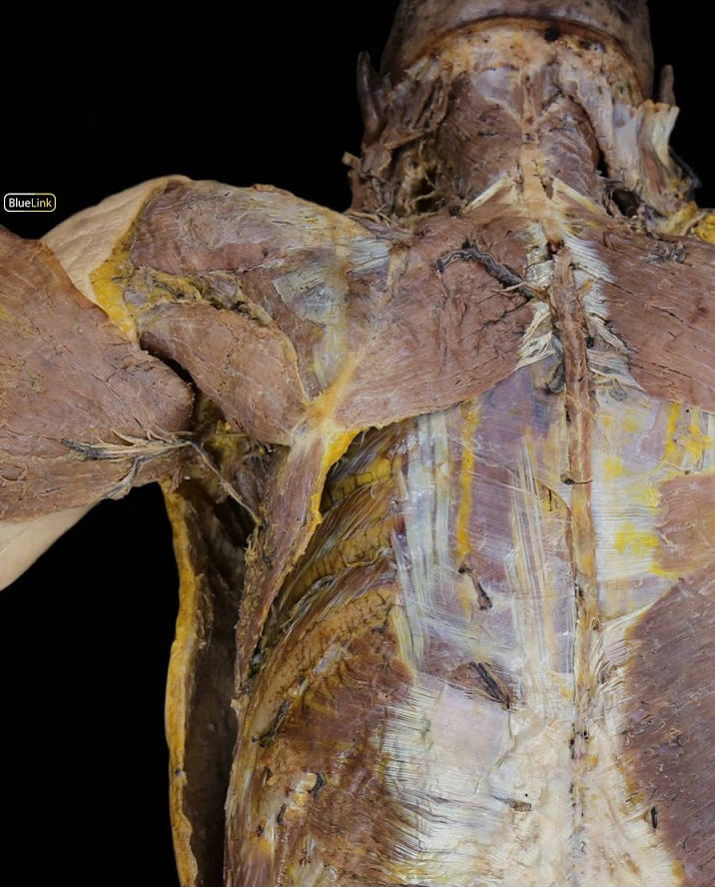
Task 1- Muscles of the back
d. Label the superficial muscles of the back indicated as ‘C’.
C.
Type your answer here:
d. Name the indicated muscle group ‘D’.
C
D.
Type your answer here:
d. What is the main function of the muscle group ‘D’.
Type your answer here:
D

Slide 5
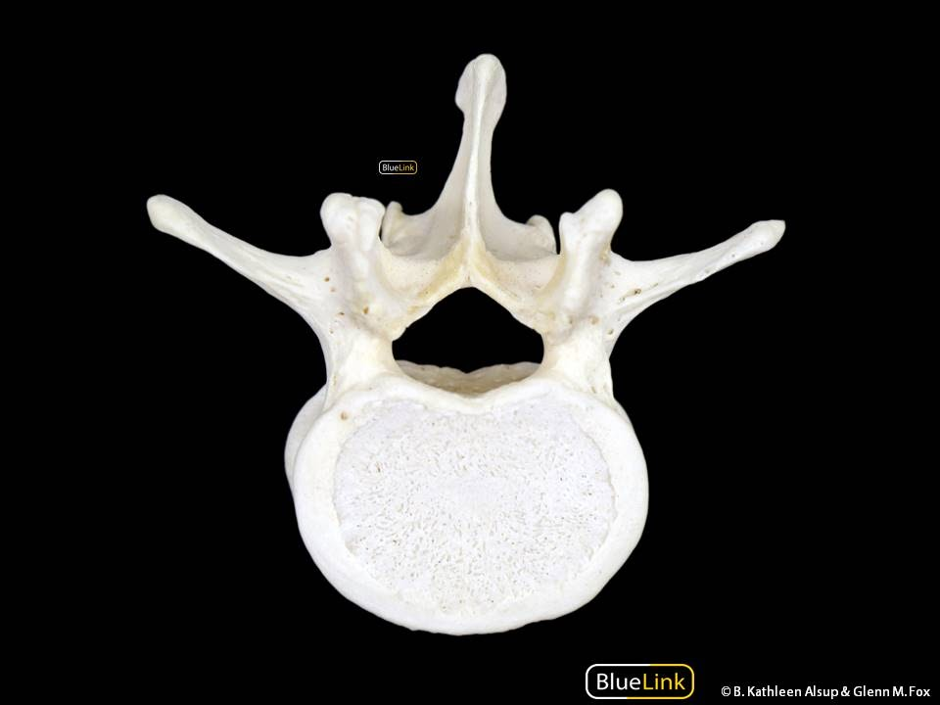
Task 2- Vertebrae
a. Label (A-D) the different parts of this typical vertebra.
Type your answer here:
A
A
Type your answer here:
Type your answer here:
B
C
D.
Type your answer here:
D

Slide 6
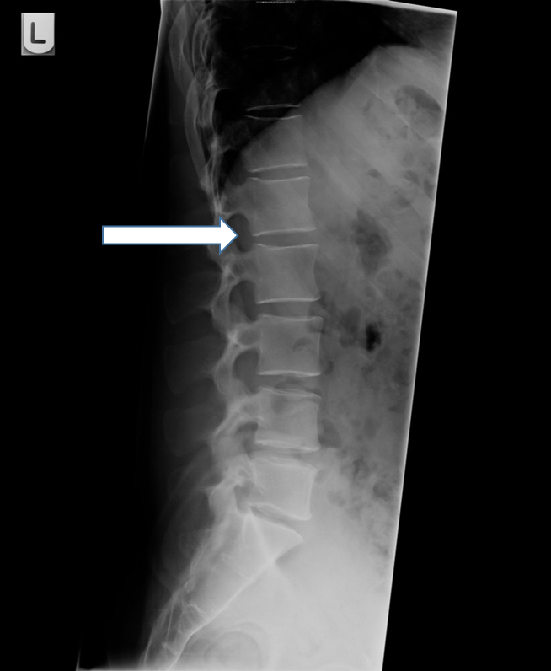
Task 2- Vertebrae
b) Name the spinal nerve that emerges at the indicated level and explain your answer.
Type your answer here:

Slide 7
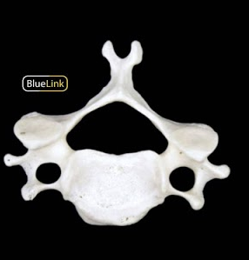
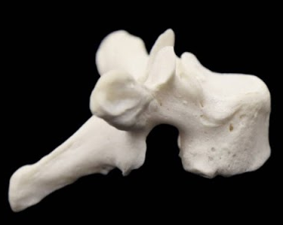
Task 2- Vertebrae
c) You are provided with different groups of vertebrae. Distinguish and classify them to belong to either cervical, thoracic or lumbar. Justify your answer.
A
B
C
Type your answer here:

Slide 8
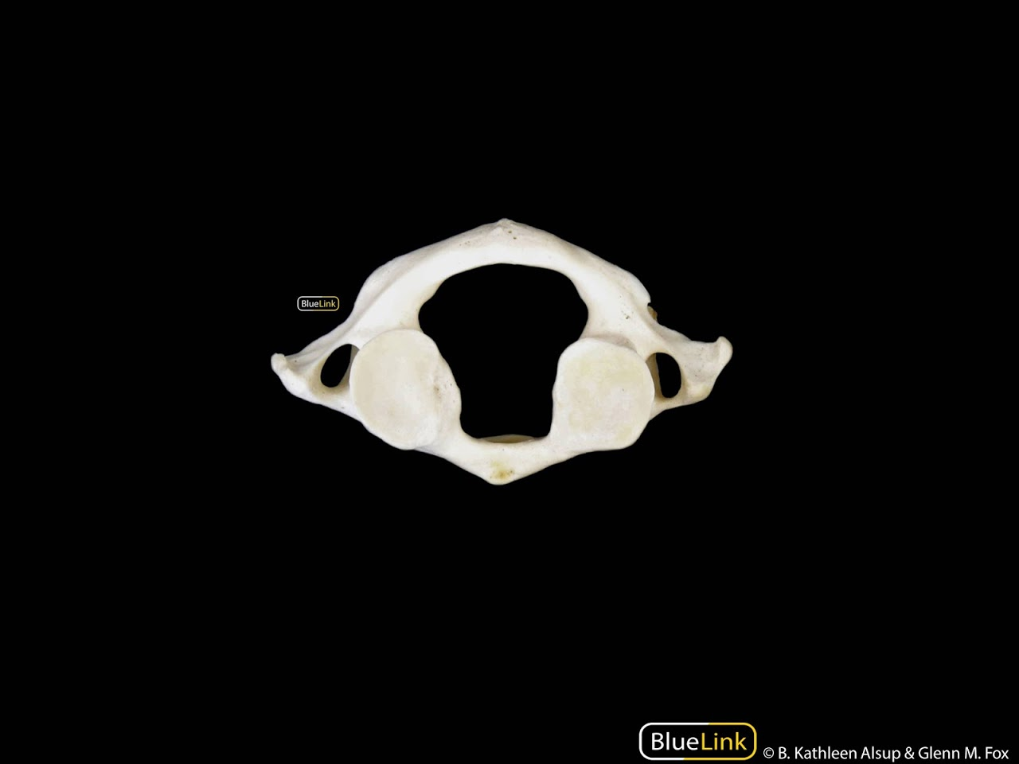
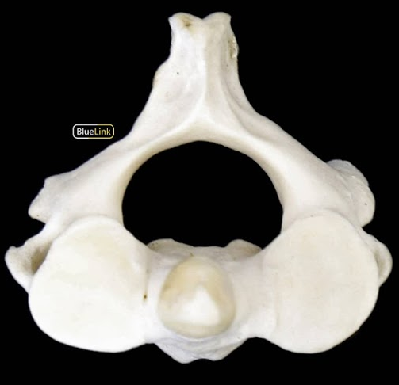
Task 2- Vertebrae
d) You are provided with two vertebrae. Name them and classify them to belong to either cervical, thoracic or lumbar. Would they be classified as typical or atypical vertebrae. Justify your answers.
A
B
Type your answer here:

Slide 9
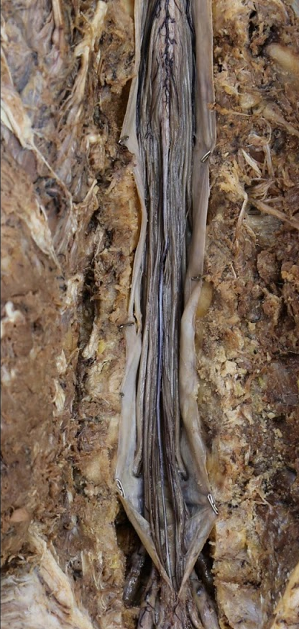
Task 3 – Spinal cord and its meninges
a. Label (A-D) the different parts of the spinal cord.
Type your answer here:
A
B
Type your answer here:
Type your answer here:
C

Slide 10
Task 3 – Spinal cord and its meninges
b. Using the different drawing options available on PowerPoint, draw the different layers of the meninges that wrap around the spinal cord.
c. Between which layers would you expect to find the cerebrospinal fluid (CSF)?
Type your answer here:
d. At what vertebral level does the spinal cord terminate in an adult and in a child?
Type your answer here:
e. Why does the spinal cord for an adult terminate at a higher vertebral level?
Type your answer here:

Slide 11
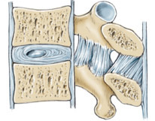
Task 4 – Ligaments of the spine
a. Name the different ligaments indicated A-E in the image below.
Type your answer here:
A
B
Type your answer here:
C
D
Type your answer here:
E
D.
Type your answer here:
E.
Type your answer here:

Slide 12
Task 4 – Ligaments of the spine
b. What is the literal translation of ligament ‘C’?
c. The ligament indicated by ‘E’ in the previous image is known by a different name when it present in the cervical region. Name the ligament at the cervical region and briefly describe its function.
Type your answer here:
Type your answer here:

Slide 13
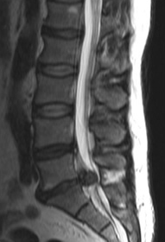
Task 5 – Intervertebral disc
a. In the MRI image of spine, indicate the pathology.
Type your answer here:
b. At what vertebral level Is the indicated pathology?
Type your answer here:
c. Explain, why such pathologies are common at this level.
Type your answer here:
d. What would be the clinical presentation in this patient?
Type your answer here:
e. What is the “general” term given to pathology that causes pain that radiates in a dermatomal distribution down the leg?
Type your answer here:

Slide 14
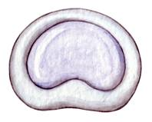
Task 5 – Intervertebral disc
f. In the image, name the different parts of the intervertebral disc.
A -
Type your answer here:
A
B -
Type your answer here:
g. Which of these part leads to prolapse of the disc?
B
Type your answer here:
g. Explain the mechanism of injury for disc prolapse?
Type your answer here:

Slide 15
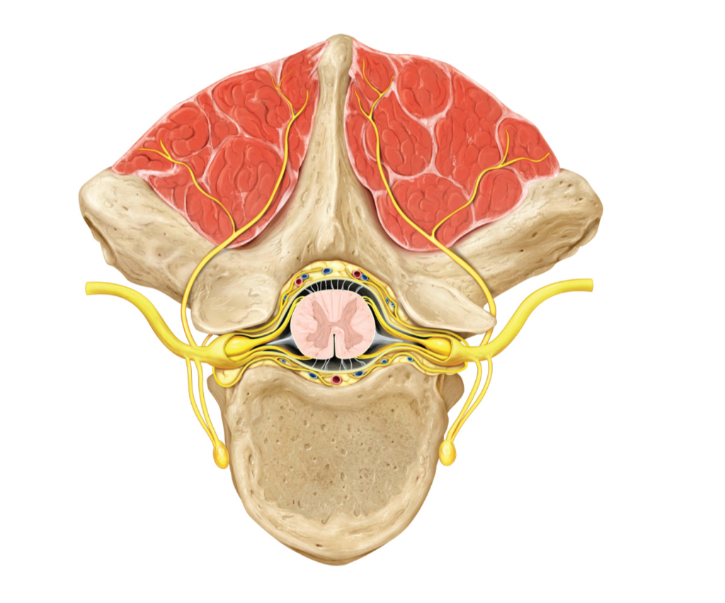
Task 6 – Lumbar Puncture
a. Spinal and epidural are the two common types of spinal anaesthesia. On the image indicate the
Epidural space
Subarachnoid space
b. Discuss with your team the advantages and disadvantages of spinal and epidural anaesthesia and note your points onto a table below.

Slide 16
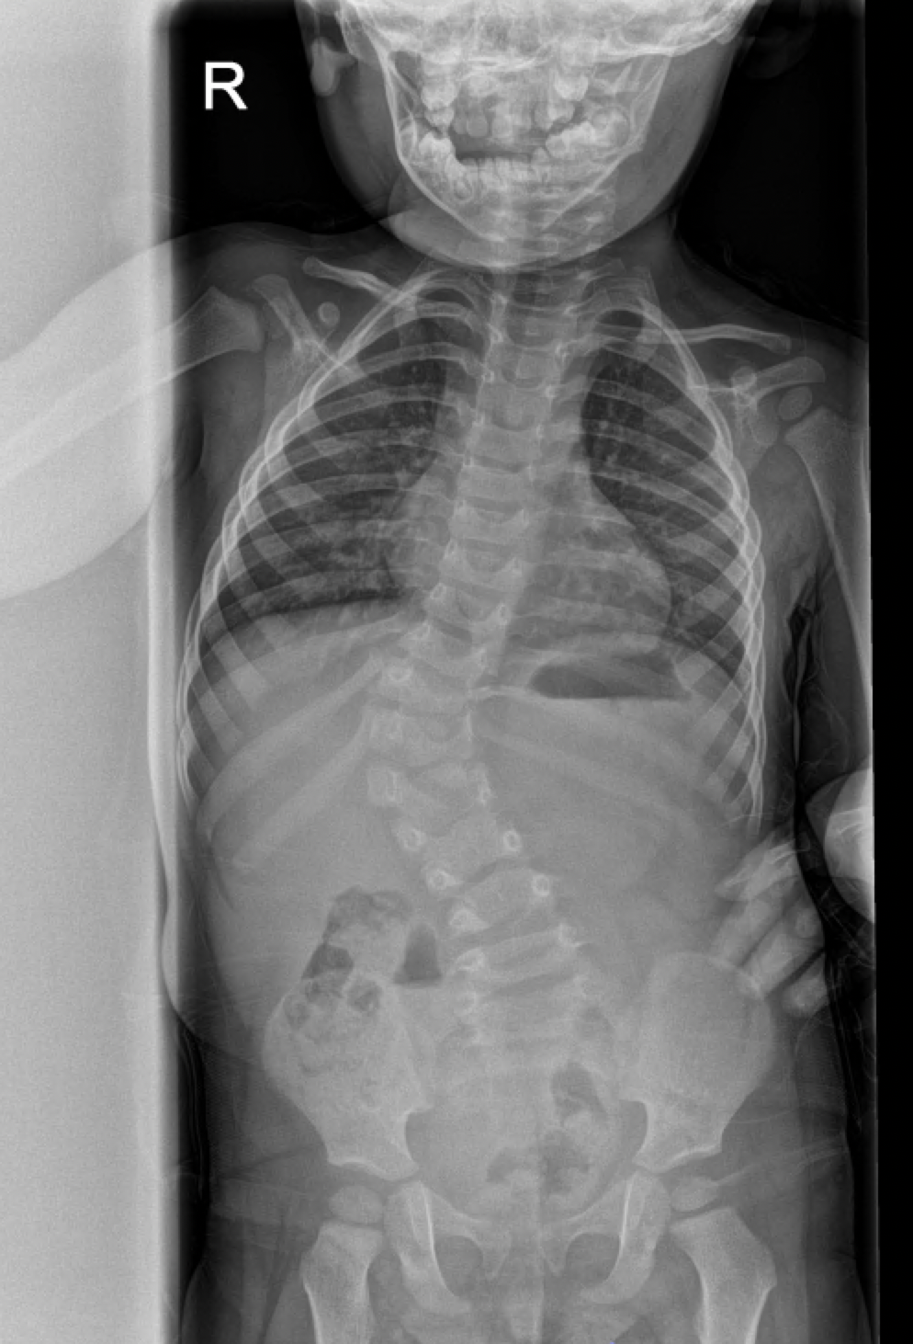
Task 7 – Applied Anatomy
1. This is the scoliogram of a 3-year-old. What is the cause of the scoliosis?
Type your answer here:
2. What other congenital anomalies might the child have?
Type your answer here:
3. What are the 3 main causes of congenital scoliosis?
Type your answer here:
4. What embryological structure forms the anterior vertebral bodies?
Type your answer here:

Slide 17
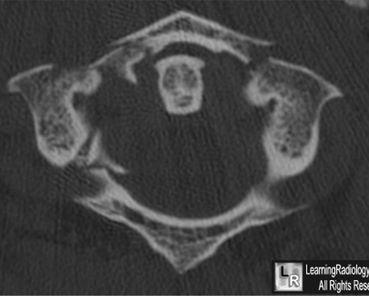
Task 7 – Applied Anatomy
d) A 33-year-old man is brought to the A&E following a dive head first into shallow water. The patient is conscious but complains of severe right sided neck pain. On examination, the patient is neurologically intact. A MRI of the patient is on your right.
1. Name and highlight the pathology that you can see on the MRI.
Type your answer here:
2. Briefly describe the mechanism of injury for this pathology.
Type your answer here:

Slide 18
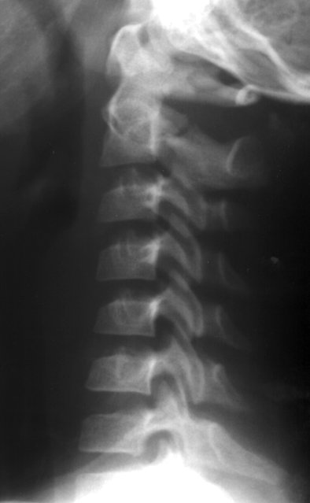
Task 7 – Applied Anatomy
e) A 46-year-old man is brought to the A&E following a hight speed road traffic accident (RTA). The patient is conscious but complains of severe neck pain. On examination, the patient is neurologically intact, without focal deficits or any signs of obvious trauma. The patient states moderate and sharp left-sided paraspinal muscle tenderness without radiation. A plain lateral neck X-Ray of the patient is on your right.
1. Name and highlight the pathology that you can see on the X-Ray.
Type your answer here:
2. Briefly describe the mechanism of injury for this pathology.
Type your answer here:

Slide 19
Task 7 – Applied Anatomy
f) Previous clinical scenarios ‘d and e’ could present with neurological deficits depending upon the severity of the fracture. Discuss with your team how vascular compromise due to arterial dissection would present with neurological presentations.
Type your answer here:
1. Which artery would you suspect to be affected in these clinical scenario.
Type your answer here:
2. From which artery does the above artery arise?
Type your answer here:

Slide 20
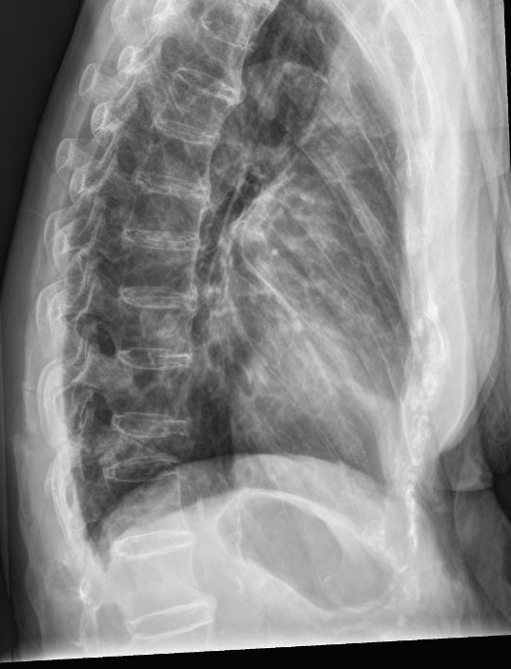
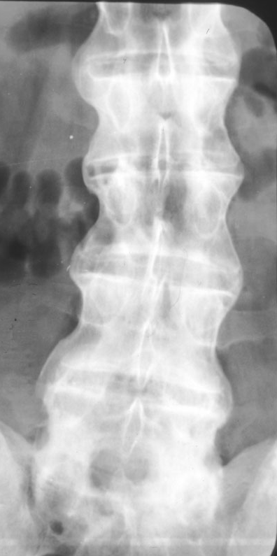
Task 7 – Applied Anatomy
1. These are the X-Rays of a 60-year-old male who had a minor fall 3 months ago. They have a history of a stiff back, uvitis, colitis and skin problems. What does the thoracic XR show?
Thoracic
Lumbar
Type your answer here:
2. Mark the following on the image
T9 pedicle
T9/10 foramen
3. What medical condition do you think the patient suffers from?
Type your answer here:
4. What does the lumbar spine look like?
L1
Type your answer here:

Slide 21
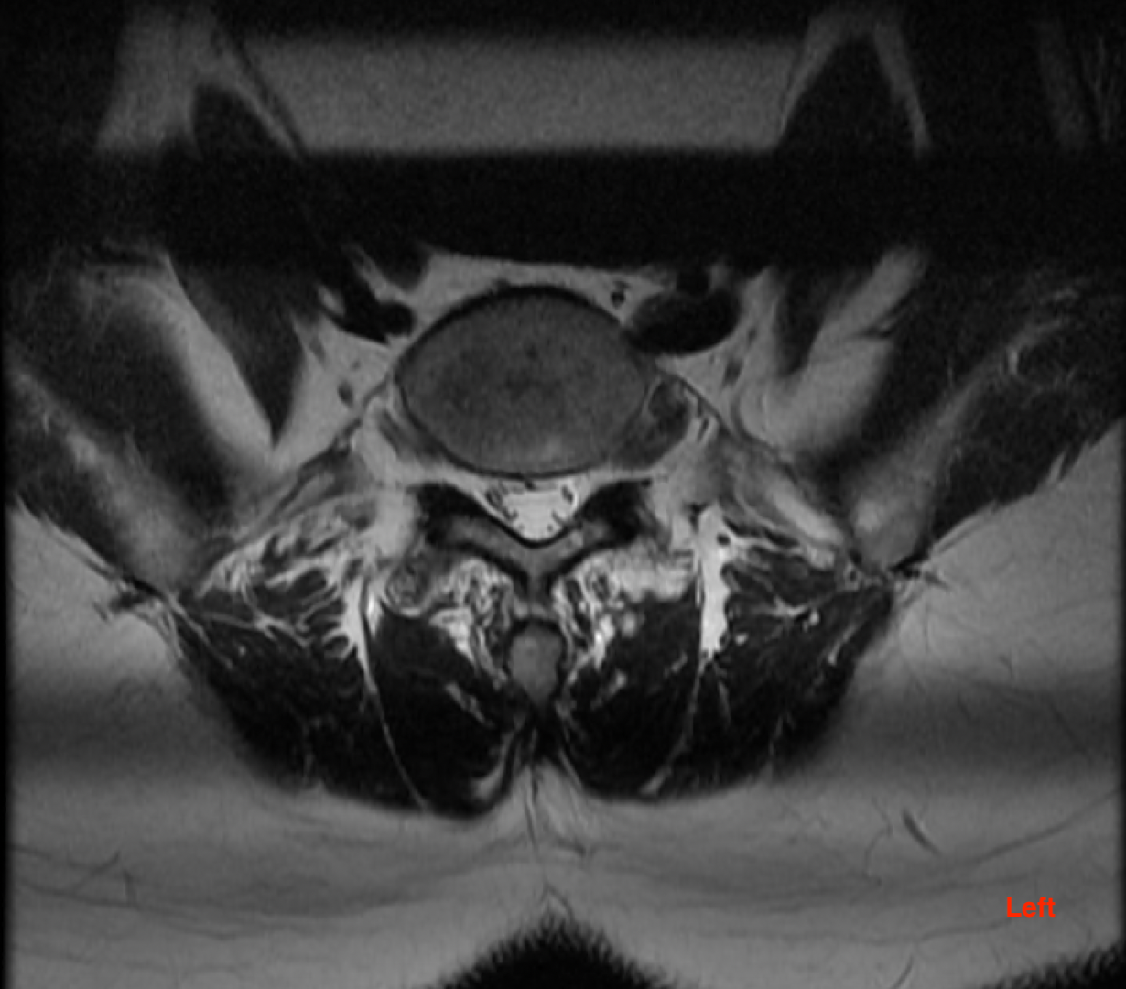
Task 7 – Applied Anatomy
1. This is an axial MRI image through the L5/S1 disc.
The patient has left leg pain. What is the cause?
Type your answer here:
2. Which nerve root does it affect?
Type your answer here:
3. Where will the patient experience pain?
Normal right L5 nerve root exiting
Type your answer here:
4. According to the ASIA chart how would you test the myotome and where would you test for sensation?
Type your answer here:

Slide 22
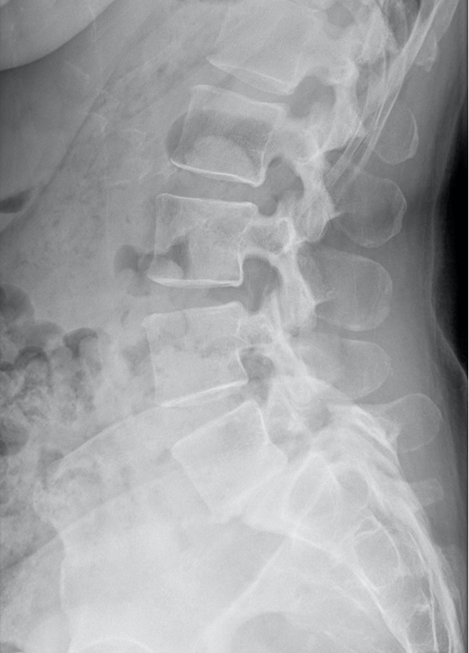
Task 7 – Applied Anatomy
This is a lateral X-Ray of a patient with low back pain and bilateral leg pain.
Mark the L2/3 neural foramen
2. Which nerve roots are being affected in this case?
Type your answer here:
3. Where will the patient experience pain in the legs?
Type your answer here:
4. What is the pars interarticularis? Mark the L3 pars interarticularis
Type your answer here:
5. What is the diagnosis?
Type your answer here:

Slide 23
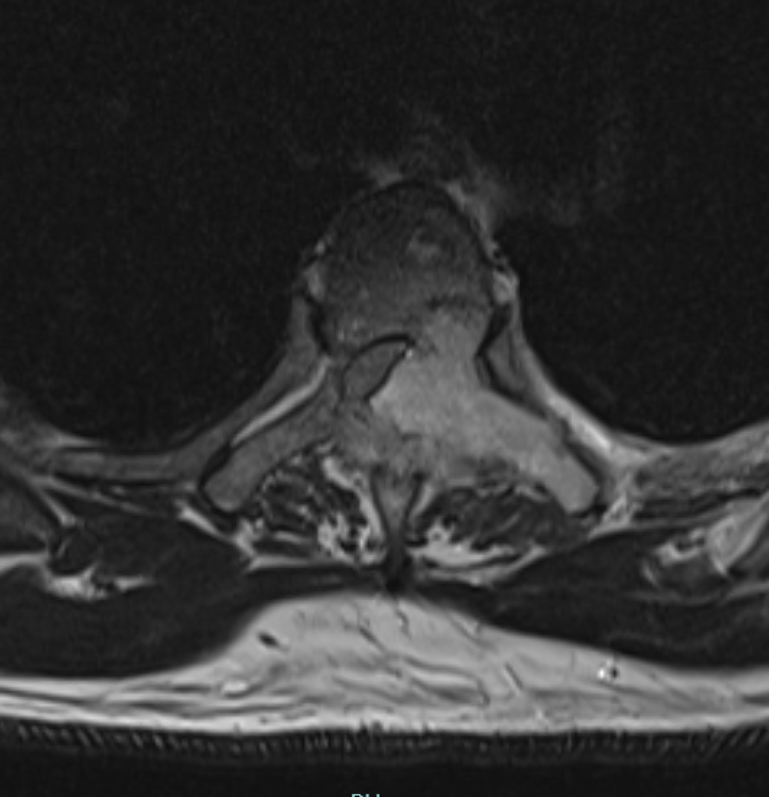
Task 7 – Applied Anatomy
This is an axial MRI through T4 in a patient with known metastatic prostate cancer. Mark the following structures on the image:
A costovertebral joint
The Spinal cord
The tumour
A costotransverse joint
A transverse process
Rhomboid major
Trapezius

